Slide 1




SMART ENERGY
Federator Project IRM2.4
Presented by :
ALOUI Houcem
ABBASSI Momtez
HAMMOUDA Ons

Slide 2


02
01
03
Team Roles
Definition and Scope
Three Layers Architectre
Project Overview
05
04
06
Monitoring Applications
Predictive Energy Consumption Model
Conclusion and Future Prospects

Slide 3



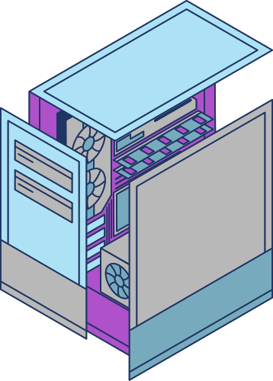
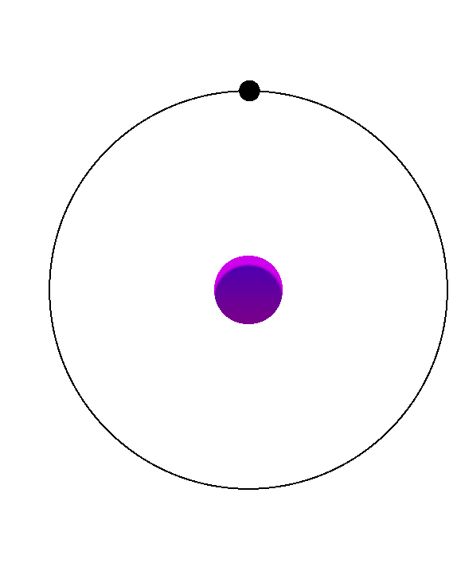

Definition and Scope
The "Smart Energy Management System for Buildings" is a cutting-edge IoT solution addressing the urgent need for efficient energy use.
Through real-time monitoring, data analytics, and predictive modeling, the system provides insights and recommendations to optimize energy usage by Hight performance GPUs. This Presentation outlines the project's context, motivation, and methodology.

Slide 4




Development Framework & Team Roles
Agile methodology with iterative sprints
ABBASSI
Momtez
HAMMOUDA Ons
ALOUI HOUCEM
Hardware setup data storage solutions & predictive analytics
Conception & sensor integration for energy monitoring
Backend development & Frontend development

Slide 5




Three Layers Architectre
Physical layer
Network layer
Application layer
The ESP32 microcontroller integrates with sensors to monitor voltage and current. Calculations for power and energy consumption are performed onboard before transmitting data to MQTT topics.
MQTT facilitates efficient data transfer between the ESP32 and Firebase, ensuring low-latency communication
Historical and real-time data.
Predictive trends using linear regression.
Customized recommendations to improve energy efficiency

Slide 6

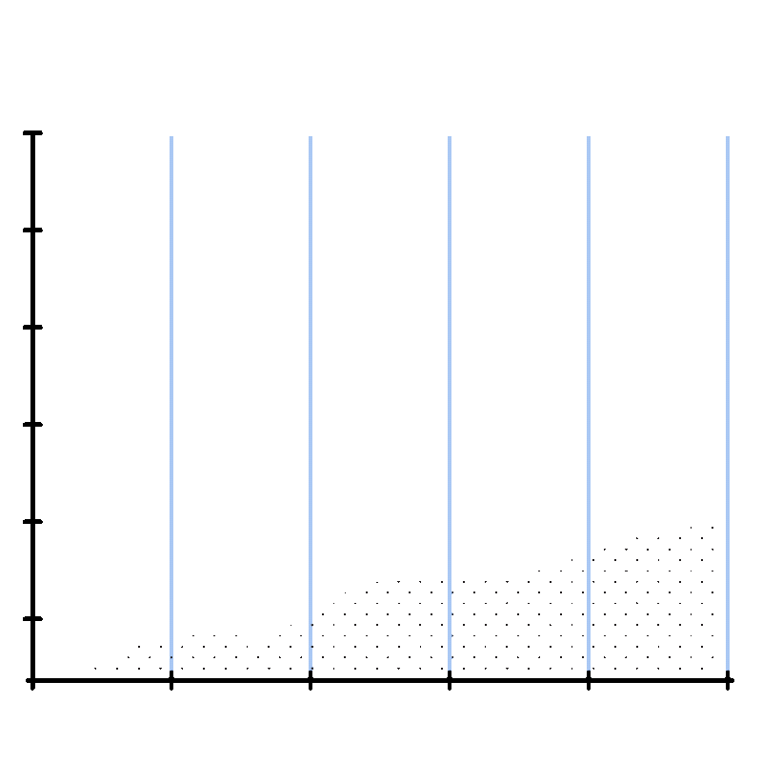
Predictive Energy Consumption Model
Predicting Energy Consumption of GPUs in Cryptocurrency Mining
Objective: Predict energy consumption of edge devices (GPUs) in a building using machine learning.
Using a dataset of energy consumption, we adapt the variables to match the output data from our devices. This allows us to perform data analysis, data processing, and training. We then visualize the fundamental patterns of linear regression in the form of a detailed notebook

Slide 7


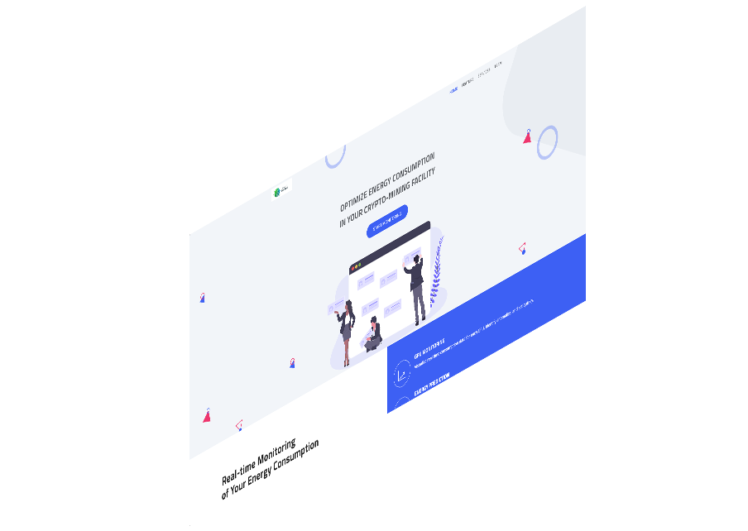
Web
Application
The web app displays
Historical and real-time data.
Customized recommendations to improve energy efficiency.
Challenges and Solutions
Calibration: Fine-tuning sensors for accuracy.
Scalability: Ensuring Firebase handles growing data volumes efficiently.
Integration: Seamless communication between components.

Slide 8


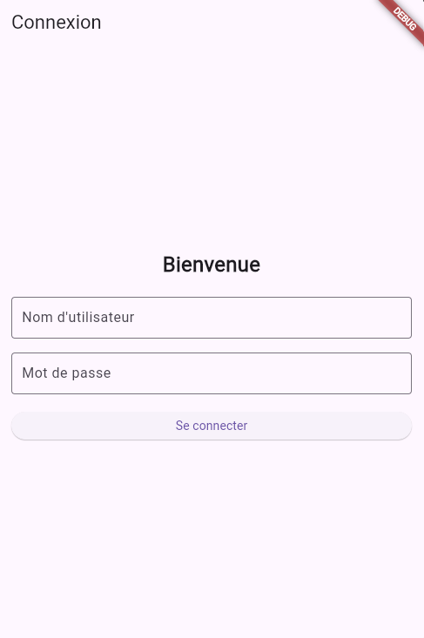

MOBILE
APPLICATION
The web app displays
Historical and real-time data.
Customized recommendations to improve energy efficiency.

Slide 9






Conclusion and Future Prospects
While the current system addresses key challenges in energy monitoring for crypto-mining factories, there are opportunities for further development. One notable enhancement involves the integration of actuators into the system. These actuators could enable automated actions, such as dynamically adjusting the power limits of GPUs or shutting down devices during periods of anomalous energy consumption. By adding this capability, the system would move from passive monitoring to active management, further optimizing energy usage and reducing operational risks.
https://www.youtube.com/watch?v=x9J0NdV0u9k

Slide 10

Thank You!
Get In Touch
With us
https://github.com/houcemaloui/SmartEnergie_IRM2-4.git

